Slide 1
Climate Change and Agriculture: Challenges for a Sustainable Future
Eugene S. Takle
Professor
Department of Agronomy
Department of Geological and Atmospheric Science
Director, Climate Science Program
Iowa State University
Ames, IA 50011
Sustainable Ag Colloquium
Spring 2011
Iowa State University
12 January 2011

Slide 2
Outline
Why are we now on an unsustainable path?
What will it take to get off this path?
What are the consequences of not getting off this path?
What are the current climate trends in Iowa?
How is agriculture now being affected?
Policy recommendations

Slide 3
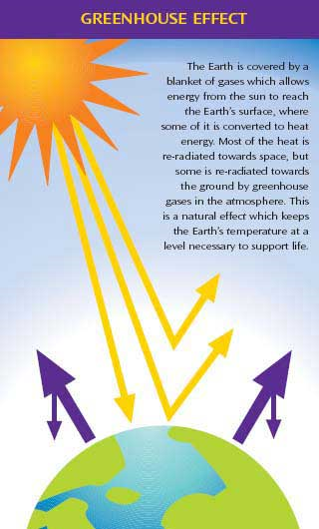
Why does the Earth warm? 1. Natural causes
THE GREENHOUSE EFFECT…
…is 100% natural.
Heat is trapped in the atmosphere.
…sustains life on Earth.
Keeps average temperatures at 12.8ºC (55ºF), instead of –29ºC (-20ºF).
Don Wuebbles

Slide 4
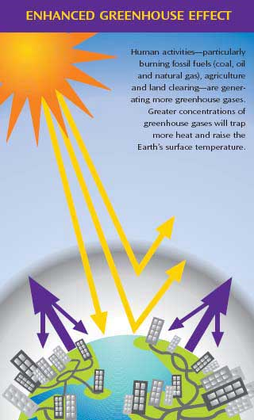
Why does the Earth warm? 2. Human causes
THE ENHANCED GREENHOUSE EFFECT
(or GLOBAL WARMING)
… is primarily human-induced: We’re increasing heat-trapping gases in the atmosphere.
… is like wrapping an extra blanket around the Earth.
Don Wuebbles

Slide 5
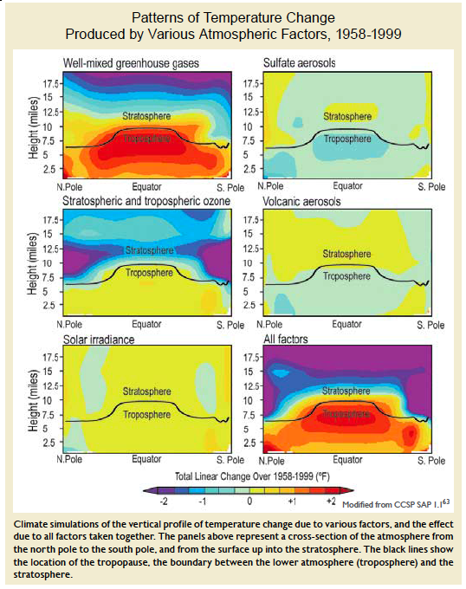
Warming of the Lower and Upper Atmosphere Produced by Natural and Human Causes
Karl, T. R., J. M. Melillo, and T. C. Peterson, (eds.), 2009: Global Climate Change Impacts in the United States. Cambridge University Press, 2009, 196pp.

Slide 6
Warming of the Lower and Upper Atmosphere Produced by Natural and Human Causes
Note that greenhouse gases have a unique temperature signature, with strong warming in the upper troposphere, cooling in the lower stratosphere and strong warming at the surface over the North Pole. No other warming factors have this signature.
Karl, T. R., J. M. Melillo, and T. C. Peterson, (eds.), 2009: Global Climate Change Impacts in the United States. Cambridge University Press, 2009, 196pp.

Slide 7
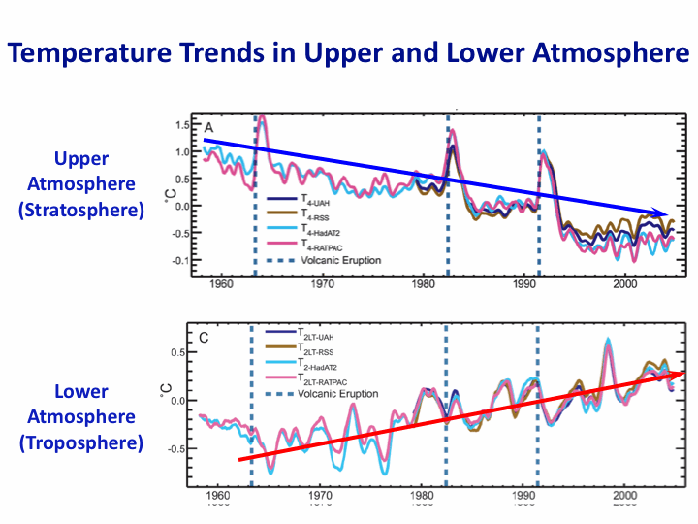
Warming of the Lower and Upper Atmosphere Produced by Natural and Human Causes
Note that greenhouse gases have a unique temperature signature, with strong warming in the upper troposphere, cooling in the lower stratosphere and strong warming at the surface over the North Pole. No other warming factors have this signature.
Karl, T. R., J. M. Melillo, and T. C. Peterson, (eds.), 2009: Global Climate Change Impacts in the United States. Cambridge University Press, 2009, 196pp.

Slide 8
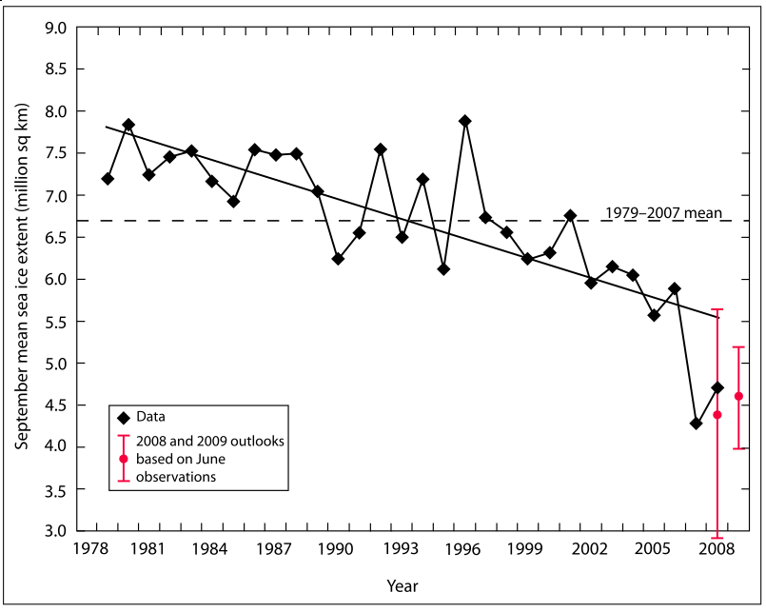
Warming of the Lower and Upper Atmosphere Produced by Natural and Human Causes
Note that greenhouse gases have a unique temperature signature, with strong warming in the upper troposphere, cooling in the lower stratosphere and strong warming at the surface over the North Pole. No other warming factors have this signature.

Slide 9
Rise in global mean temperature (ºC)

Slide 10
Rise in global mean temperature (ºC)

Slide 11
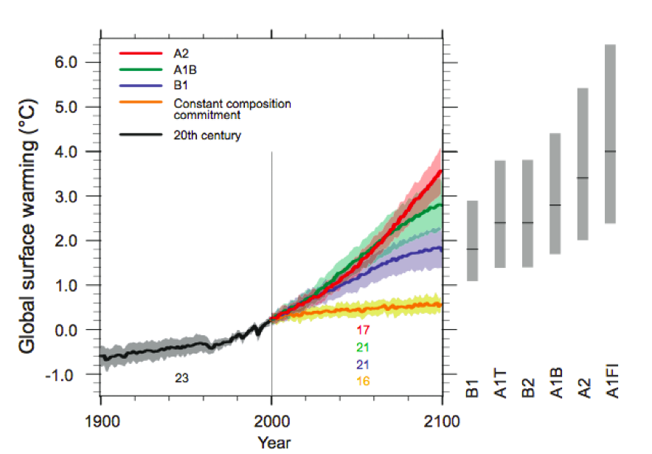
Energy intensive
Balanced fuel sources
More environmentally friendly
Limit to avoid “dangerous anthropogenic
Interference” with the climate system
2ºC limit
IPCC Fourth Assessment Report Summary for Policy Makers

Slide 12
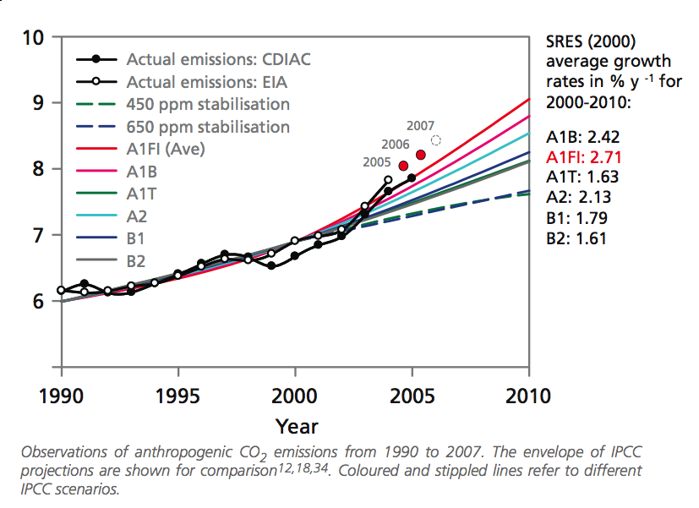
Annual Global Carbon Emissions (Gt)
2008
2009
2007
Actual emissions are exceeding worst case scenarios projected in 1990

Slide 13
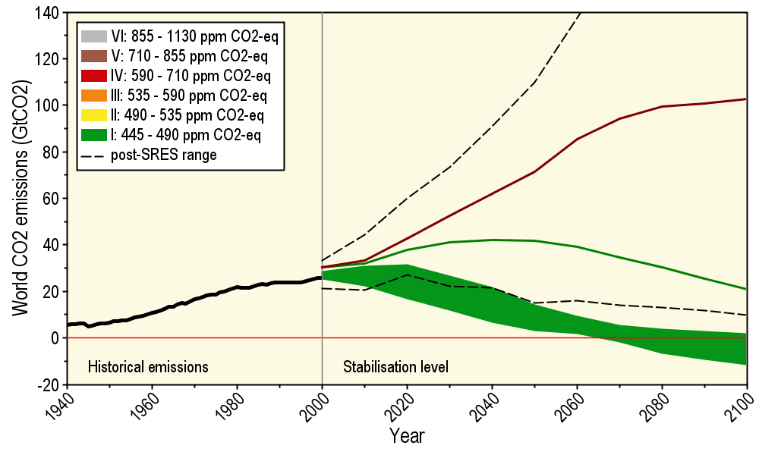
Long-Term Stabilization Profiles
A2
B1
2008
2009
Nebojša Nakićenović IIASA, Vienna

Slide 14
Long-Term Stabilization Profiles
A2
Achieving this emission reduction scenario will provide a 50% chance of not exceeding the 2ºC guardrail
B1
Carbon reductions needed will be 90 times as large
as the impact of the 2009 recession
2008
2009
Nebojša Nakićenović IIASA, Vienna

Slide 15
1 Gt = 10³ MMT

Slide 16
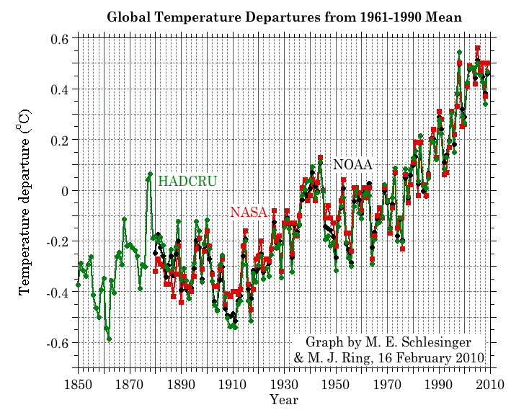
Three separate analyses of the temperature record – Trends are in close agreement
Don Wuebbles

Slide 17
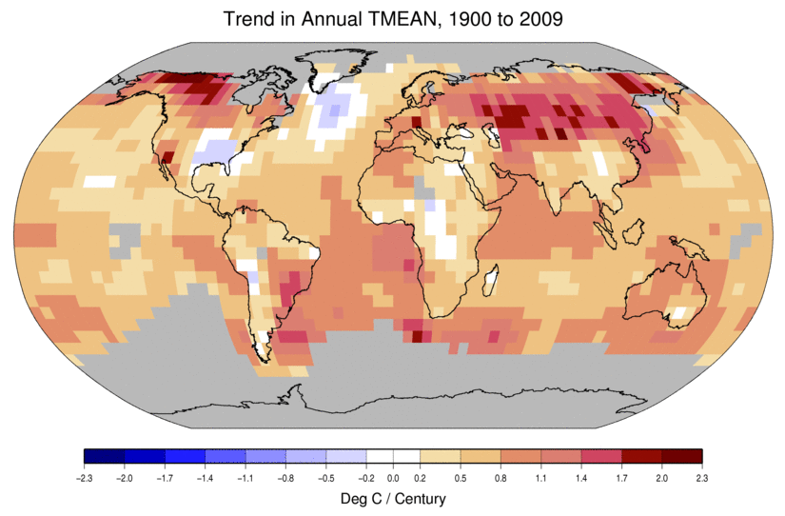
Temperature Changes are Not Uniform Around the Globe
From Tom Karl, NOAA NCDC

Slide 18
2000-2009

Slide 19
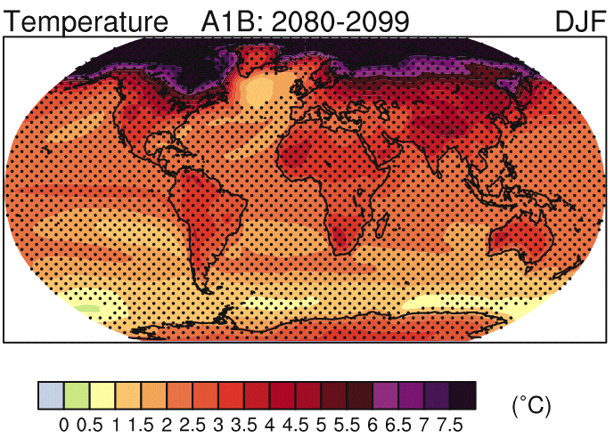
IPCC 2007

Slide 20
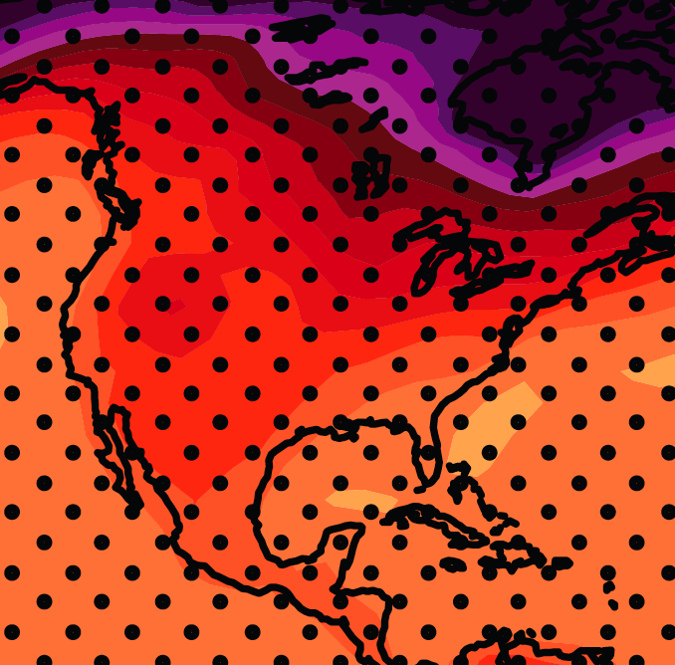
December-January-February Temperature Change
7.2ºF
6.3ºF
A1B Emission Scenario
2080-2099 minus1980-1999

Slide 21
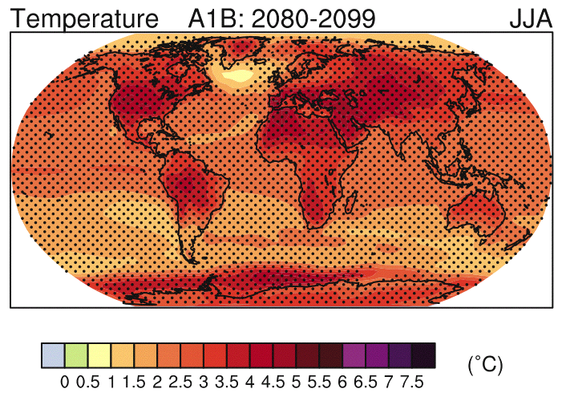
IPCC 2007

Slide 22
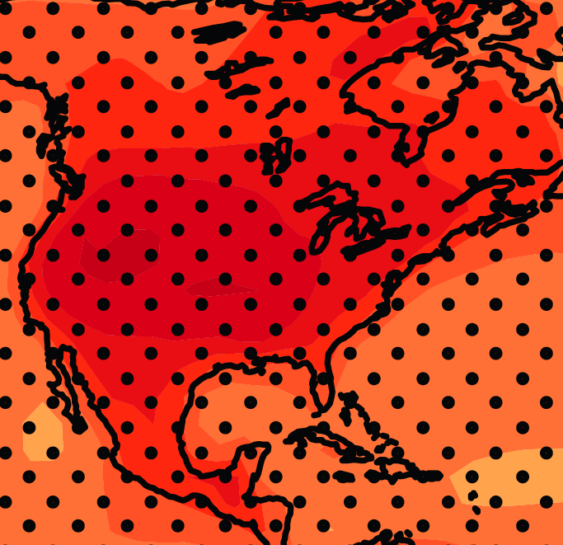
June-July-August Temperature Change
4.5ºF
5.4ºF
A1B Emission Scenario
2080-2099 minus1980-1999

Slide 23
June-July-August Temperature Change
4.5ºF
5.4ºF
A1B Emission Scenario
2080-2099 minus1980-1999
Not the direction of current trends

Slide 24
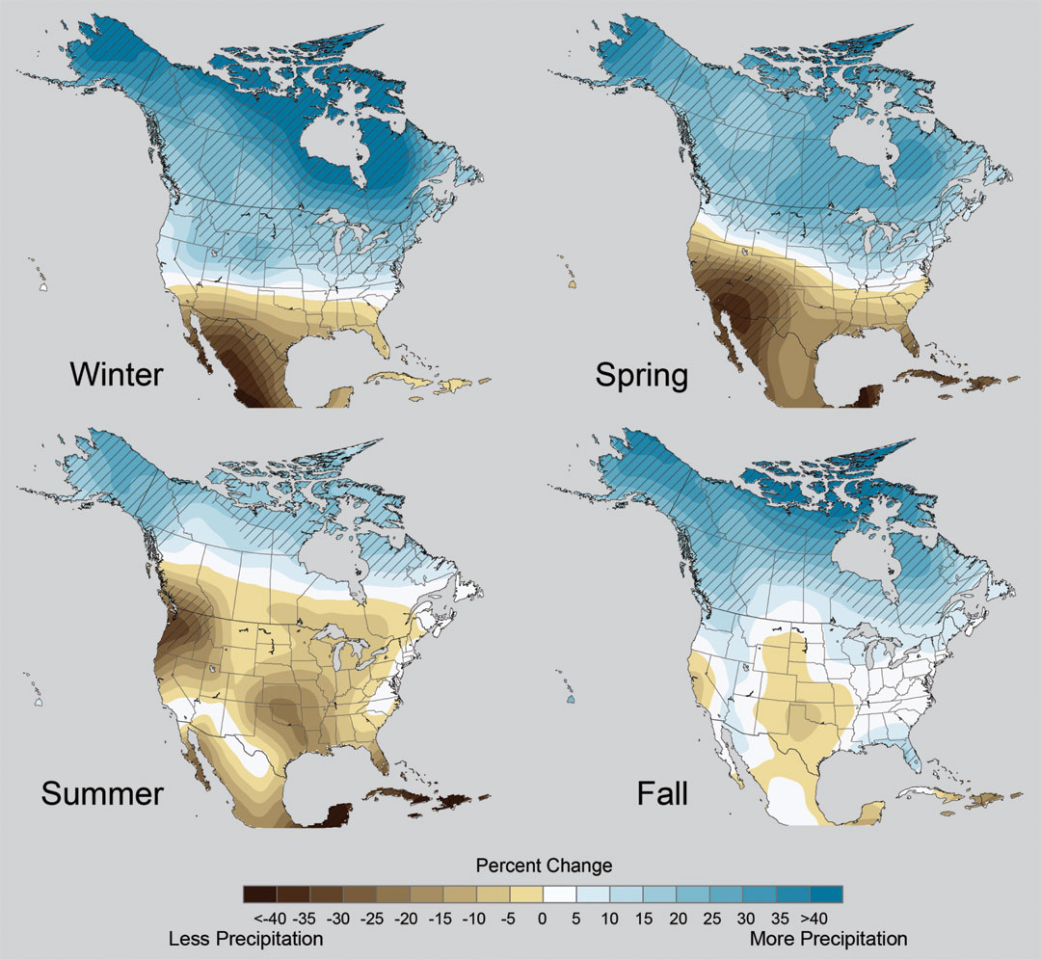
Projected Change in Precipitation: 2081-2099
Midwest: Increasing winter and spring precipitation, with drier summers
More frequent and intense periods of heavy rainfall
Unstippled regions indicate reduced confidence
Relative to 1960-1990
NOTE: Scale Reversed
Don Wuebbles

Slide 25
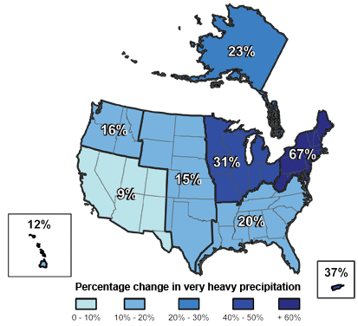
Climate changes are underway in the U.S. and are projected to grow
Temperature rise
Sea-level rise
Increase in heavy downpours
Rapidly retreating glaciers
Thawing permafrost
Lengthening growing season
Lengthening ice-free season in the ocean and on lakes and rivers
Earlier snowmelt
Changes in river flows
Plants blooming earlier; animals, birds and fish moving northward
Don Wuebbles

Slide 26
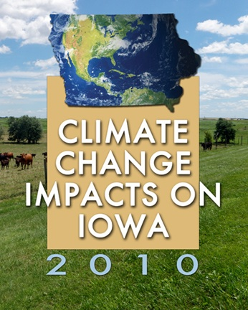
Iowa Climate Change Impacts Committee, 2011: Climate Change Impacts on Iowa.
Report to the Governor and the Iowa General Assembly. [Available online at
http://climate.engineering.iastate.edu/Document/Olson_Amend_Report.pdf]
Image courtesy of NASA/GSFC

Slide 29
Iowa Climate Change Impacts Committee, 2011: Climate Change Impacts on Iowa.
Report to the Governor and the Iowa General Assembly. [Available online at
http://climate.engineering.iastate.edu/Document/Olson_Amend_Report.pdf]
Chapter 2. Climate Changes in Iowa
Eugene S. Takle
Image courtesy of NASA/GSFC

Slide 31
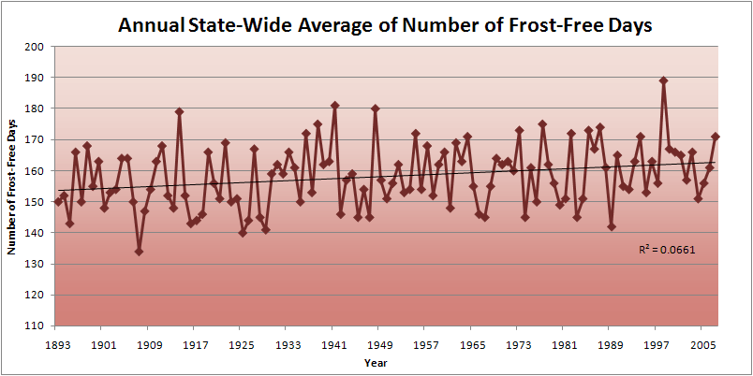
Iowa State-Wide Average Data

Slide 34
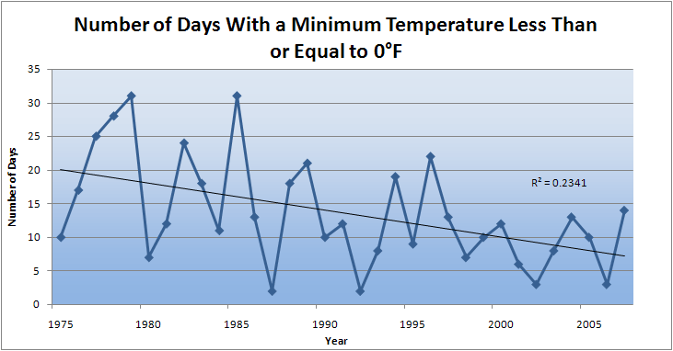
Des Moines Airport Data
Caution: Not corrected for urban heat island effects

Slide 35
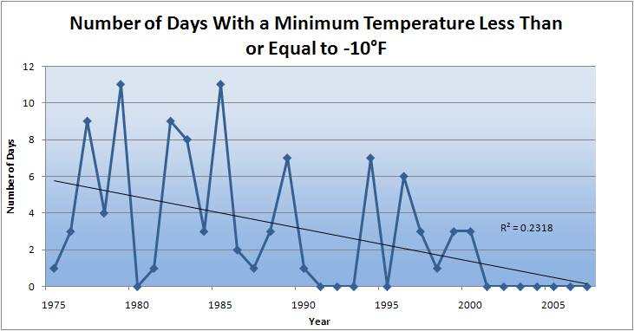
Des Moines Airport Data
Caution: Not corrected for urban heat island effects

Slide 36
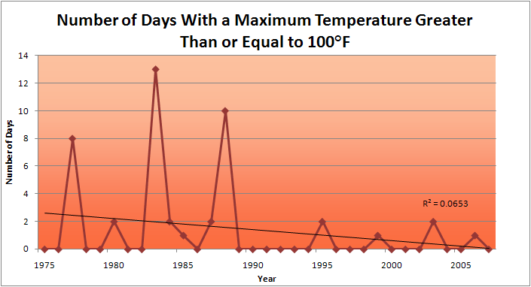
Des Moines Airport Data
1983: 13
1988: 10
1977: 8
2009: 0
2010: 0

Slide 37
Des Moines Airport Data
1983: 13
1988: 10
6 days ≥ 100ºF in the last 22 years
1977: 8
2009: 0
2010: 0

Slide 38
The summer cooling caused by current trends toward higher annual precipitation and abundant soil moisture are masking a slow and steady rise of greenhouse gas forcing that, if unmasked by successive years of abnormally low precipitation, could lead to a major heat wave and drought.

Slide 40
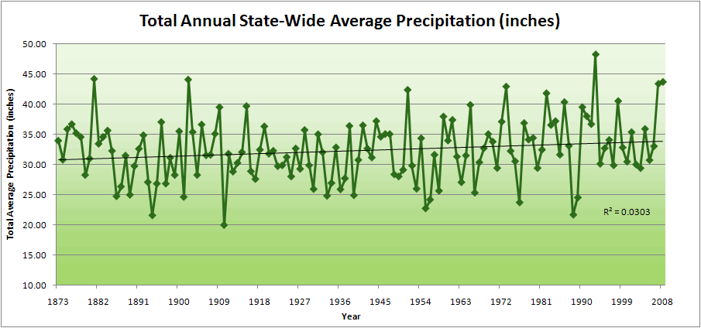
Iowa State-Wide Average Data

Slide 41
Iowa State-Wide Average Data
34.0”
10% increase
30.8”

Slide 42
Iowa State-Wide Average Data
Totals above 40”
2 years

Slide 43
Iowa State-Wide Average Data
Totals above 40”
8 years
2 years

Slide 44
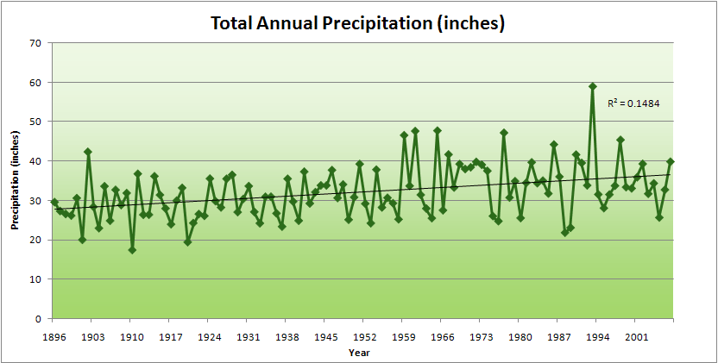
Cedar Rapids Data

Slide 45
Cedar Rapids Data
28.0”
32% increase
37.0”

Slide 46
Cedar Rapids Data
Years with more than 40 inches
11
1
28.0”
32% increase
37.0”

Slide 47
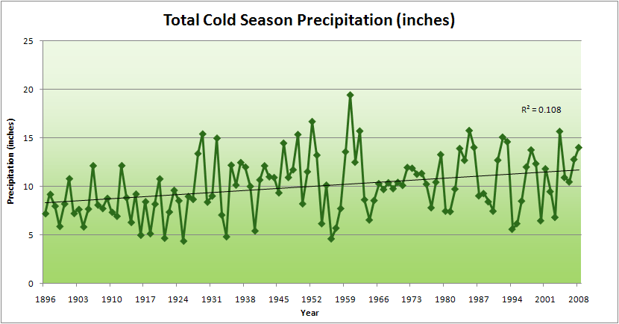
Cedar Rapids Data
51% increase
11.8”
7.8”

Slide 48
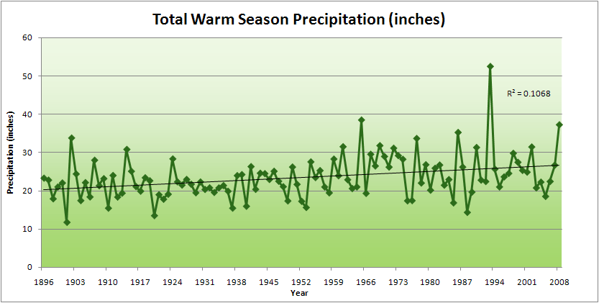
Cedar Rapids Data
34% increase
26.8”
20.2”

Slide 49
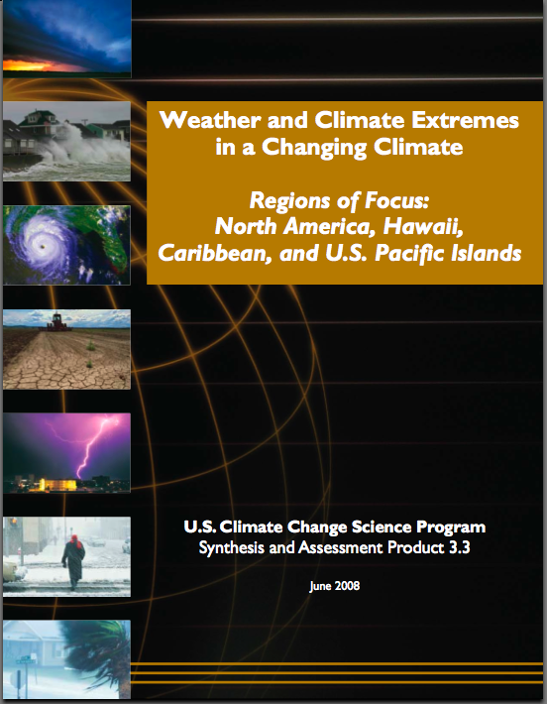
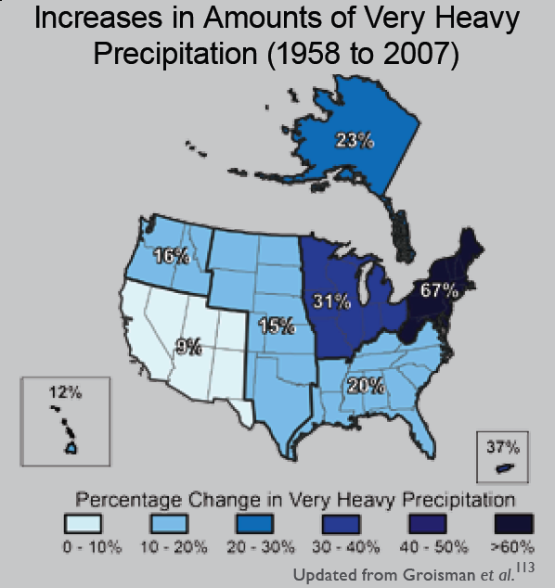
“One of the clearest trends in the United States observational record is an increasing frequency and intensity of heavy precipitation events… Over the last century there was a 50% increase in the frequency of days with precipitation over 101.6 mm (four inches) in the upper midwestern U.S.; this trend is statistically significant “
Karl, T. R., J. M. Melillo, and T. C. Peterson, (eds.), 2009: Global Climate Change Impacts in the United States. Cambridge University Press, 2009, 196pp.

Slide 50
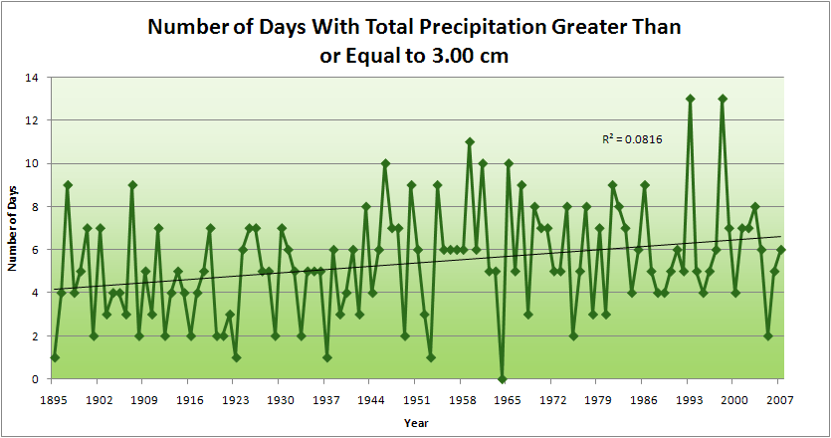
Cedar Rapids Data
4.2 days
57% increase
6.6 days

Slide 51
Cedar Rapids Data
Years having more than 8 days
13
2
4.2 days
57% increase
6.6 days

Slide 52
Years with more than 40 inches: 43% Increase
2010 so far

Slide 53
2010 through Sept 27
3.7
41% Increase
5.2

Slide 54
Years having more than 8 days
2010 through Sept 27
7
350% Increase
2
3.7
41% Increase
5.2

Slide 55
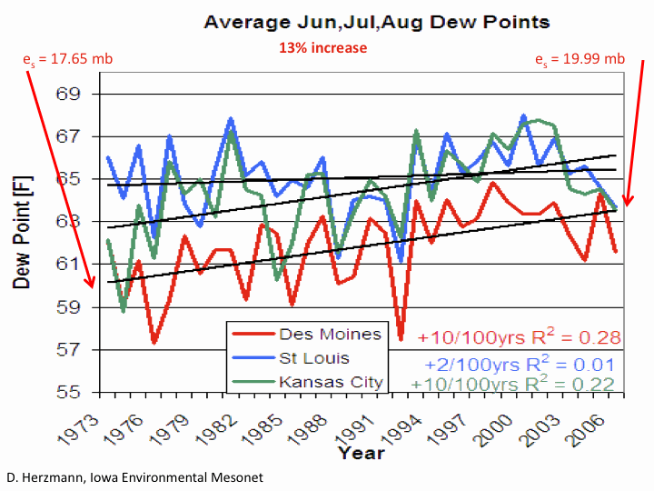

Slide 57
Iowa Climate Change Impacts Committee, 2011: Climate Change Impacts on Iowa.
Report to the Governor and the Iowa General Assembly. [Available online at
http://climate.engineering.iastate.edu/Document/Olson_Amend_Report.pdf]
Chapter 3. Agriculture in Iowa
Natalia P. Rogovska and
Richard M. Cruse
Image courtesy of NASA/GSFC

Slide 58
Iowa Agricultural Producers are Adapting to Climate Change:
Longer growing season: plant earlier, plant longer season hybrids, harvest later
Wetter springs: larger machinery enables planting in smaller weather windows
More summer precipitation: higher planting densities for higher yields
Wetter springs and summers: more subsurface drainage tile is being installed, closer spacing, sloped surfaces
Fewer extreme heat events: higher planting densities, fewer pollination failures
Higher humidity: more spraying for pathogens favored by moist conditions. more problems with fall crop dry-down, wider bean heads for faster harvest due to shorter harvest period during the daytime.
Drier autumns: delay harvest to take advantage of natural dry-down conditions
HIGHER YIELDS!!
Is it genetics or climate? Likely some of each.

Slide 59
Other Agricultural Impacts:
Carbon dioxide fertilization in field studies: corn - little or none, soybeans – up to 14%
Waterlogged soils in spring: shallow root system more prone to disease, nutrient deficiencies and drought later on; delayed planting
More frequent rains: delayed fertilizer application
More intense rain events: more soil erosion
More humid conditions, dew: plant disease, sudden death syndrome
More weeds, invasive species
Water quality: loss of nitrate fertilizer, more sediment, runoff from manure application
Animal agriculture: reduced milk production, reduced weight gain, increased mortality

Slide 62
First Day of Fall 4-inch Soil Temperature < 50ºF
(Ames, IA)

Slide 63
Nitrate Loss Through Subsurface Tile Drainage
Annual Precipitation (inches)

Slide 64
Extreme weather
events cost Iowans
$930 Million in damage
to agriculture and the
environment in 2008

Slide 65
Policy Recommendations
Climate change is already affecting the way Iowans live and work. Without action to mitigate these effects, our future responses will become more complex and costly. The following policy recommendations are offered as initial steps to help safeguard our state’s economy, environment, and residents:
Take strong steps to safeguard Iowa’s soils, water quality, and long-term agricultural productivity in the face of climate change
Iowa Climate Change Impacts Committee, 2011: Climate Change Impacts on Iowa.
Report to the Governor and the Iowa General Assembly. [Available online at
http://climate.engineering.iastate.edu/Document/Olson_Amend_Report.pdf]

Slide 66
Summary
We currently are on a path of economic growth and
emissions of greenhouse gases that is unsustainable
The transformation to a sustainable path will be costly
with major changes in our use of energy
Agriculture in Iowa both benefits and is negatively
impacted by climate change, but negative impacts will
increase with time with serious consequences for our
soil and water resources

Slide 67
Questions?

